Slide 1


Student Loan Repayment & Refinancing

Slide 2

The Credit Union Difference
Better Value
As a not-for-profit, HUECU puts members first in the form of better rates on savings and loans, lower & fewer fees, and more free services and perks.
Better Service
Credit unions consistently outperform banks in metrics of customer service and satisfaction. You have a name not just an account number here.
Better Business Model
The member controlled co-op model is always focused on operating in the best interests of our members.
Better For the Community
Your money stays local when you bank with HUECU. We give back to our community by offering financial education programs and support for local charitable organizations.

Slide 3

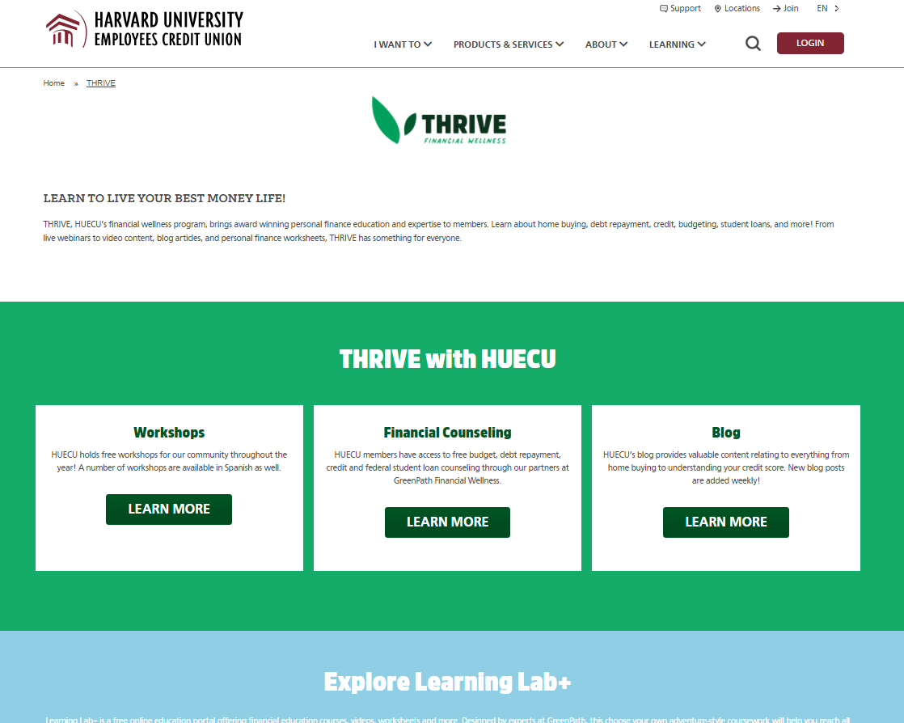
THRIVE
Financial Wellness
Free Financial Counseling, Blogs, Workshops, Worksheets, Short Videos, Calculators and online education portal.
HUECU.ORG/THRIVE
Notes:
I would suggest moving this to the end of the show

Slide 4
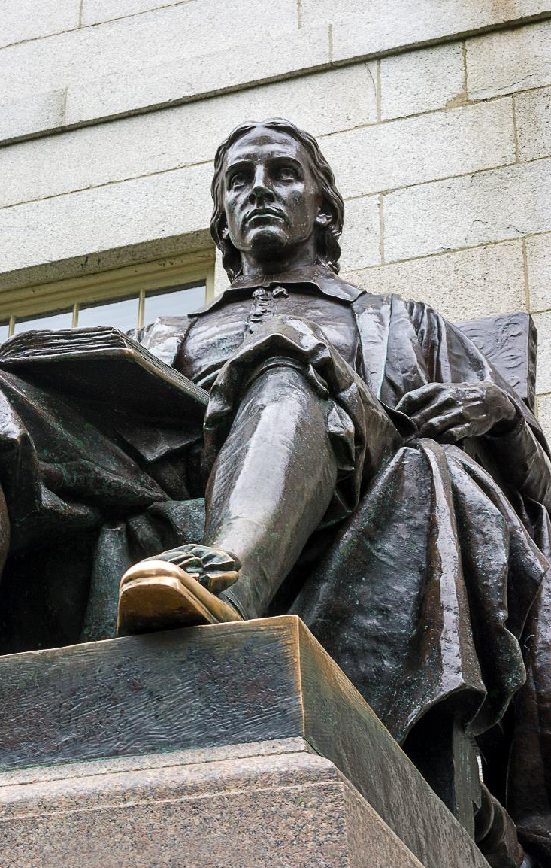
Steps To Student Loan Repayment
1
Your Student Loans
Understand what types of loans you have.
2
Repayment Options
Know what your repayment options are.
3
Research
Research your federal forgiveness and discharge options.
4
Refinancing Options
Consider if refinancing is an option for you.
Notes:
Animate is click for each step

Slide 5

STEP 1
Understand your loans.

Slide 6
Types of Student Loans
1
Federal
Direct subsidized and unsubsidized, and PLUS (parent and graduate).
2
State
Varies by state.
3
Private
Offered by credit unions, banks, universities/schools and private companies.

Slide 7
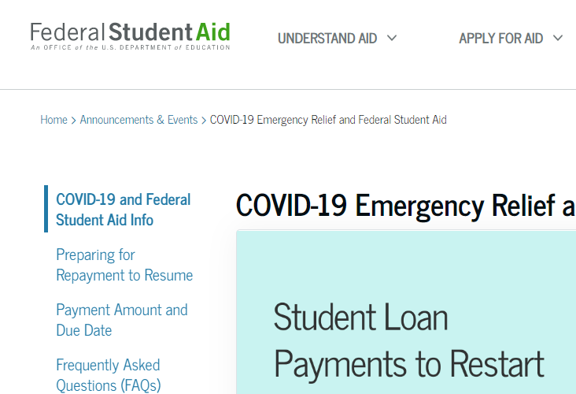
STUDENTAID.GOV
studentaid.gov/announcements-events/coronavirus

Slide 8


Federal Direct Subsidized and Unsubsidized Loans
Formerly Stafford Loans
Deferment
Federal loans have changed, you might see Stafford or Direct Loans.
You can defer while enrolled at least half-time.
No Credit Check
Grace Period
The student is borrower, no credit check required.
After graduating you have a 6 month grace period before payments start.
Subsidized
Rates
Subsidized loans are only available to undergraduates.
Your rates are based off when you borrowed the loan.

Slide 9
Federal Plus & Graduate Plus Loan
 | PLUS | GRADUATE PLUS
BORROWER | Parent (student must complete FAFSA) | Student
GRACE PERIOD | None, but can request deferment | 6 months
INTEREST RATE | Varies, depending on when loan was disbursed | $468
LENDER | Department of Education | $972

Slide 10



Private Student Loans
Lender Options
Terms Vary Based On Lender
Potential Benefits
Borrowed through bank, credit union, private company.
You can shop around for interest rates. Grace periods may differ from lender to lender as well as repayment terms.
Co-signer release options. Interest Rate reduction with auto-pay.

Slide 11

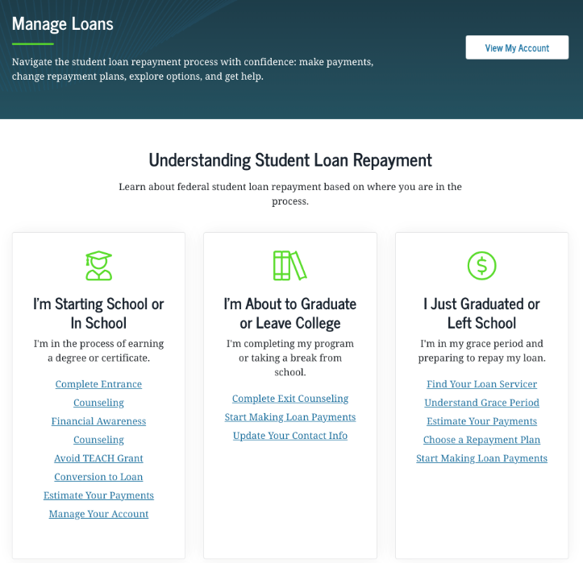
Know The Details
AMOUNTS
RATES
TERMS
More information on Federal Loans
STUDENTAID.GOV

Slide 12
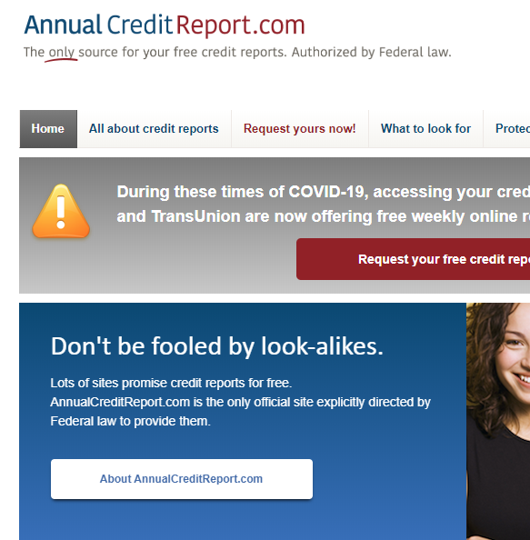
Free Credit Report
Receive a free weekly copy of report from each of 3 bureaus until April 2022.
ANNUALCREDITREPORT.COM

Slide 13

STEP 2
Know Your Repayment Options

Slide 14
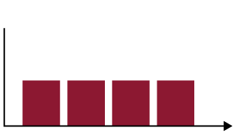
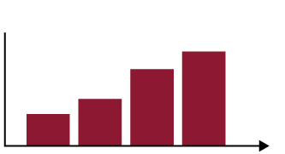
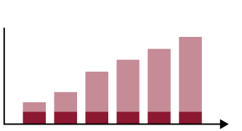
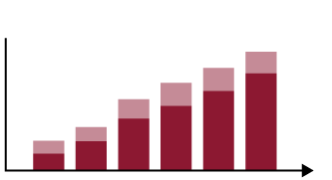
Federal Repayment Options
Basic Repayment Plans
Income-Driven Plans
Traditional plans for paying off federal student loans.
Plans that are sensitive to post-grad income.
INCOME-BASED
PAY AS YOU EARN
STANDARD
GRADUATED
EXTENDED
INCOME-CONTIGENT
10
10
25
20-25
REVISED AS YOU EARN
YEARS
YEARS
YEARS
YEARS
INCOME-SENSITIVE

Slide 15
Deferment and Forbearance
Contact your federal and private loan servicer if you are unable to make payments. There are options to help you.
Federal Deferment
Forbearance
Allows you to pause payments under certain conditions such as enrolled at least half-time in school.
If you don’t qualify for deferment, allows you to temporarily postpone repayment.

Slide 16
What Happens If I Missed Payments?
Future Borrowing
Higher Bills
May affect ability to borrow future federal loans.
It may increases the amount you need to repay.
Credit Score
Government Intervention
Negatively impacts credit report.
Government may garnish wages, tax refunds, social security benefits and other income.
Notes:
Animate is click for each step

Slide 17

STEP 3
Research Your Federal Forgiveness
and Discharge Options

Slide 18

Forgiveness & Discharge Options
studentaid.gov/manage-loans/forgiveness-cancellation
Closed School Discharge
Discharge Due To Death
Teacher Loan Forgiveness
Unpaid Refund Discharge
Perkins Loan Cancellation and Discharge
Borrower Defense Discharge
Total and Permanent Disability Discharge

Slide 19
Public Service Loan Forgiveness (PSLF)
studentaid.gov/manage-loans/forgiveness-cancellation/public-service
Monthly Payments
Repayment Plan
Full-Time Employer
Forgives remaining balance on Direct Loans after you have made 120 qualifying monthly payments.
Forgiveness is only granted under a qualifying repayment plan.
You must be working full-time for a qualifying employer.
Notes:
Animate is click for each step

Slide 20
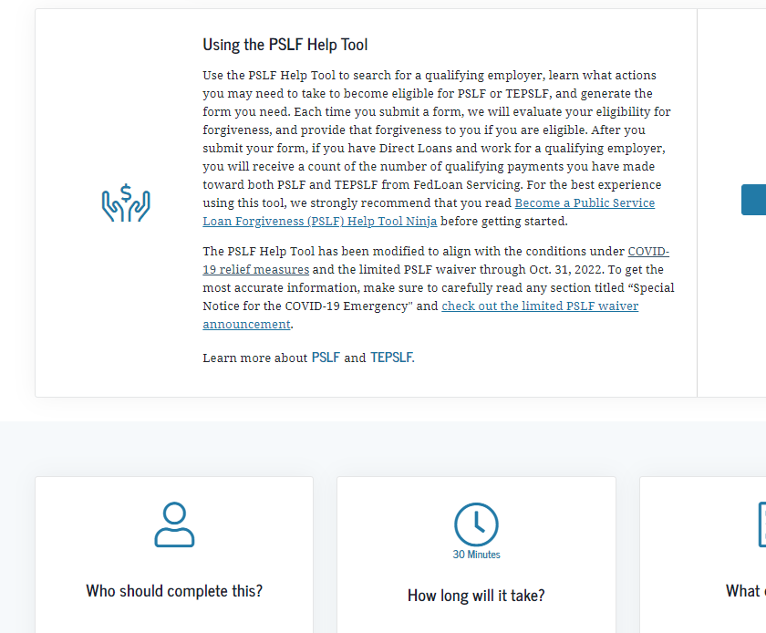
STUDENTAID.GOV/PSLF

Slide 21

STEP 4
Consider Refinancing

Slide 22

What is Refinancing?
A new loan that combines private and/or
federal loans into one new loan.
BENEFITS OF REFINANCING
May lower your monthly payment
One monthly bill and one interest rate
Typically, no application fee and no prepayment penalties
Federal Consolidation is different from private refinancing.
Notes:
Animate is click for each step

Slide 23
What to Consider Before Refinancing
*Some lenders offer interest rate discounts for automatic loan payments.
Interest Rate
Benefits
Repayment Term
Based off credit score.
May lose benefits associated with original loans.
Typically begins right away.
Notes:
Animate is click for each step

Slide 24
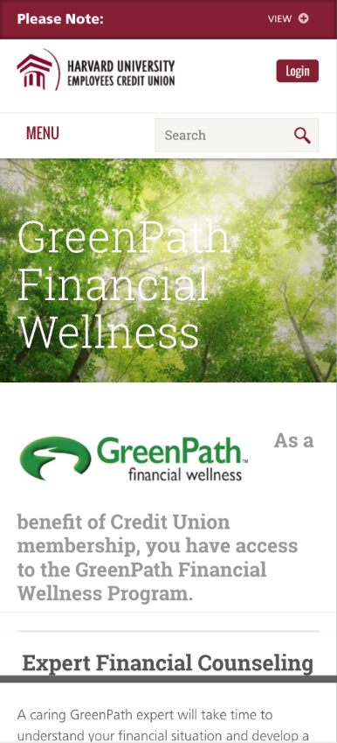
GreenPath
GreenPath Financial Wellness offers free credit, budget and COVID-19 counseling.
HUECU.ORG/GREENPATH

Slide 25
Repayment Strategy
 | AMOUNT | INTEREST RATE | MONTHLY PAYMENT | LOAN TERM (MONTH) | TOTAL INTEREST PAID
CURRENT LOAN | $40,000 | 8.5% | $552 | 103 (8.6 years) | $16,314*
NEW RATE & TERM | $40,000 | 5.5% | $434 | 120 (10 years) | $12,093
NEW RATE & ORIGINAL PAYMENT | $40,000 | 5.5% | $552 | 89 (7.4 years) | $8,726
NEW RATE & INCREASED PAYMENT | $40,000 | 5.5% | $575 | 84 (7 years) | $8,280
*Does not include interest you previously paid

Slide 26
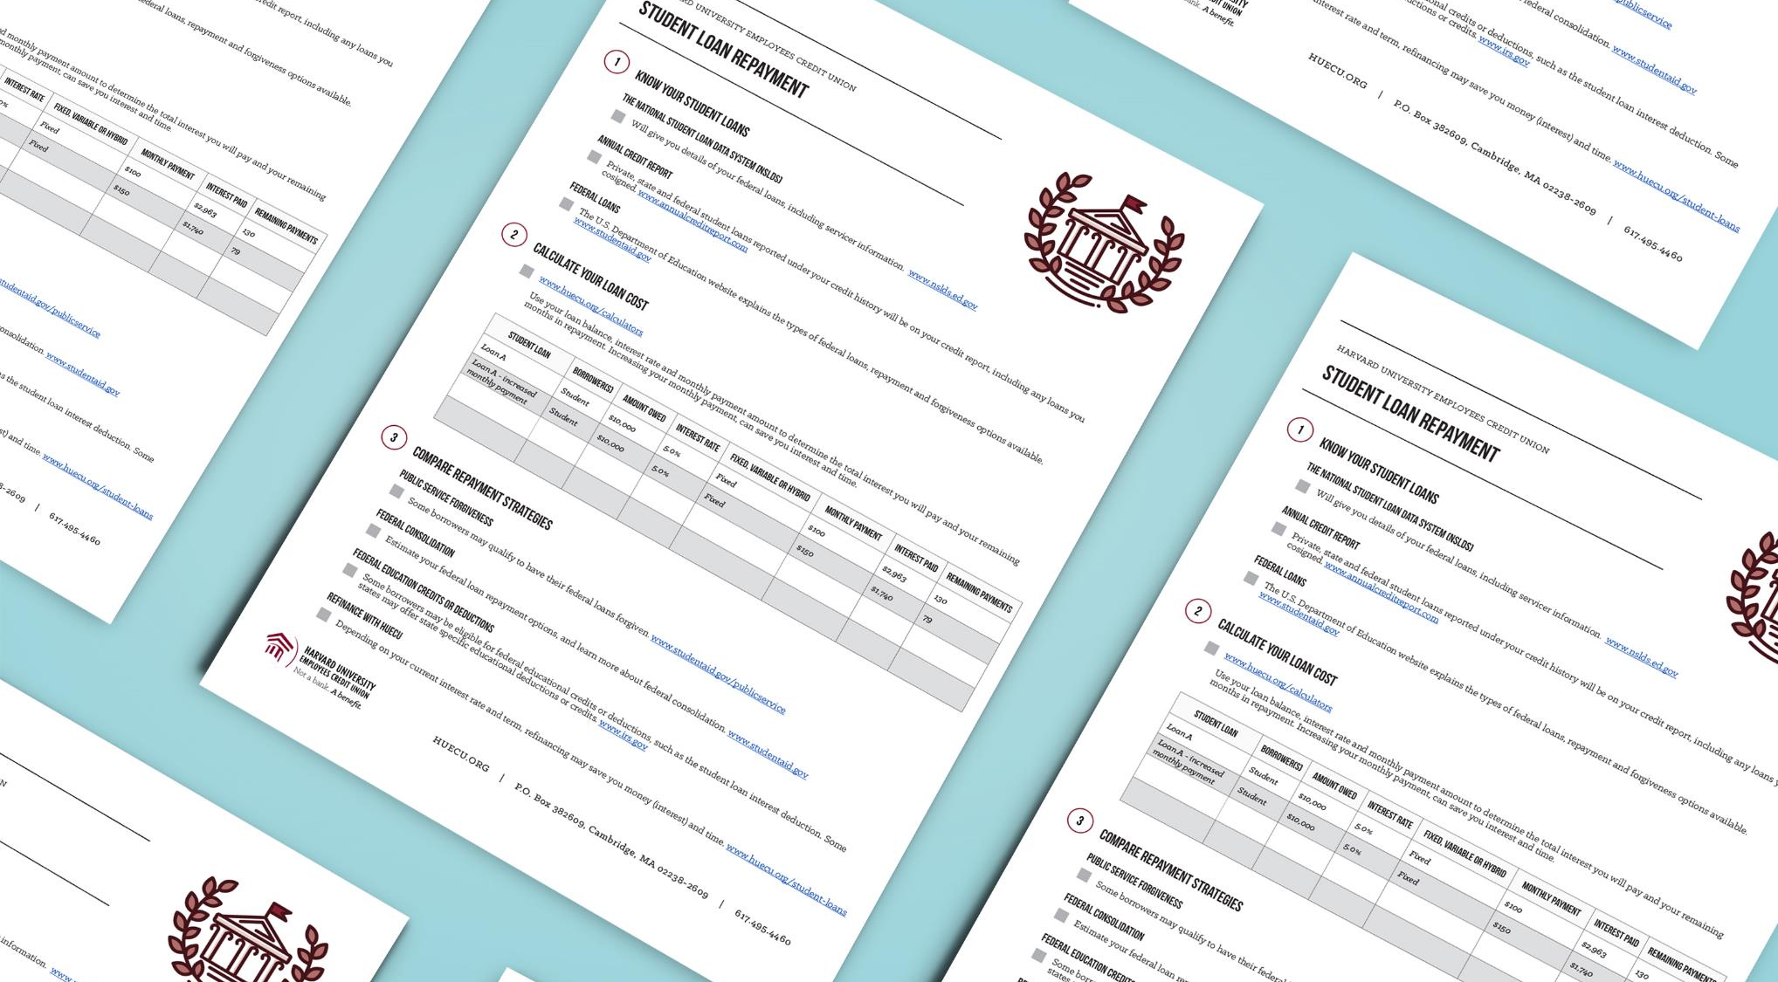

Slide 27
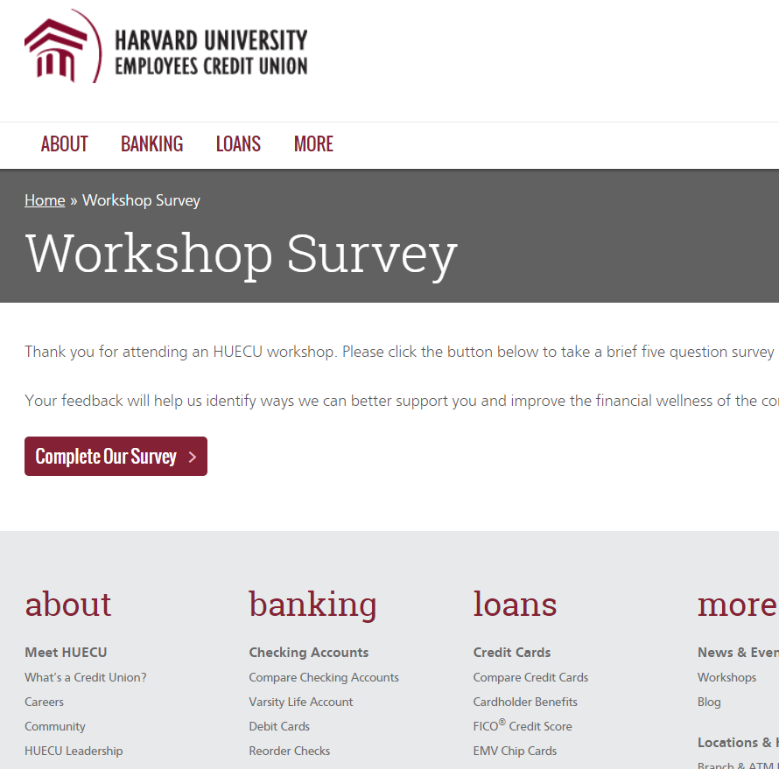
Survey Says
Be sure to let us know what you thought
of this webinar in our online survey.
HUECU.ORG/SURVEY

Slide 28

Next Steps
1
Do Your Homework
Complete your student loan repayment chart.
2
Research
Research loan forgiveness options.
3
Crunch The Numbers
Calculate refinancing savings.

Slide 29
Disclaimer
This presentation is a general overview of principles you may want to consider. Only you can decide what is best for you. This presentation is educational in nature and is not intended to be, and should not be construed as tax, legal or investment advice. You should always consult a certified advisor for advice on your specific situation. The examples used in this presentation are for illustrative purposes only.
Notes:
Does this work for the below slide?

Slide 30






Keep in
Touch
huecu@harvard.edu
huecu.org
@myHUECU
Find us on all social channels
104 Mount Auburn Street
Cambridge, MA 02138

